Slide 1
Building Service and Fire Protection Equipment
Identify the appropriate building service and fire protection equipment
Explain the commissioning process and integrated testing

Slide 2
Historic Fire
One Meridian Plaza

Slide 3
Chapter Design
Requirements for systems used in building
Most requirements are to other codes
  Those codes are then part of NFPA 101

Slide 4
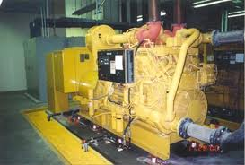
Utilities
Emergency power
  Will be required elsewhere in code
  NFPA 110
  Generator running, fault, not in automatic

Slide 5
Air Movement
HVAC and other ventilation
  Other codes
Smoke control
  Automatic activation
  Engineer of record certifies intent and method
  Special inspector

Slide 6
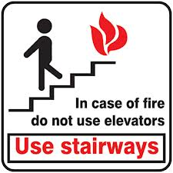
Elevators
Unless in accordance with 7.2.13 only exit access
Specific signage in non evacuation elevator lobbies
Available for fire fighter emergency operations
  Elevator machine room limits

Slide 7
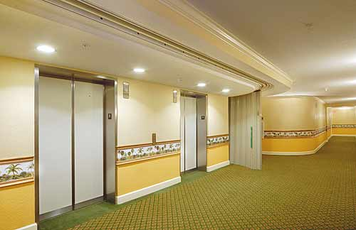
Elevators
Cannot open to an exit enclosure

Slide 8
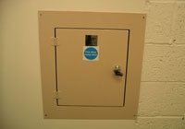
Chutes
Connect multiple levels
Must be in designated room

Slide 9
Detection and Alarm Systems
NFPA 70 and NFPA 72
Alarm out of service > 4 hr = notify AHJ
  Evacuation
  Fire watch
Smoke detection to protect system
Must notify fire department

Slide 10
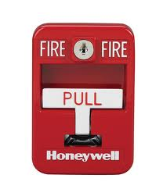
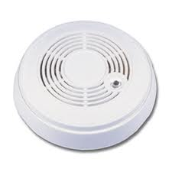
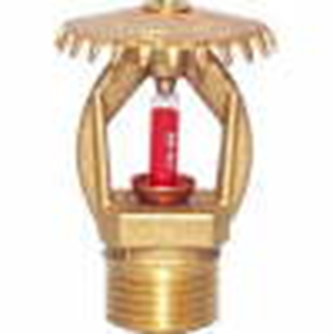
Detection and Alarm Systems
Initiation
  Pull station
    Within 60 in of doorways
    Within 200 ft of all locations
    Occupancy chapters might only require one in building
  Smoke/heat detector
    Sleeping areas
    Interconnected
    Local
  Suppression system
    Equal or greater than single sprinkler

Slide 11
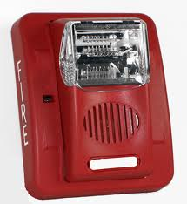
Detection and Alarm Systems
Notification
  Audible and visual
    Must be heard above ambient, distinct, take precedence
    Must be synchronized
  Detection away from occupied = no notification
  Delay to “trained” staff
  Notification to entire evacuation zone
  Private operating mode allowed
  520 Hz in sleeping areas

Slide 12
Detection and Alarm Systems
Alarm zones
  Each floor
  Maximum 22,500 ft²
    300 ft in one direction
  Can align with sprinkler system zones
CO detection
Risk analysis
  Where required
  MNS not explicitly required
Two-way radio enhancement

Slide 13
Detection and Alarm Systems
Voice Alarms
  Intelligibility and audibility
  Vulnerable populations
  More information
  Less confusion
  Required in some buildings
Mass Notification
  Relatively new in the codes
  Wide range of applications
  Not required

Slide 14
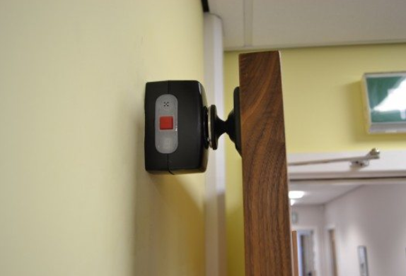
Detection and Alarm Systems
Relation to other systems
  Hold-opens
  Pressurization
  Smoke management/control
  Door locks
  Elevator recall
  HVAC

Slide 15
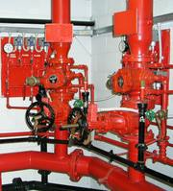
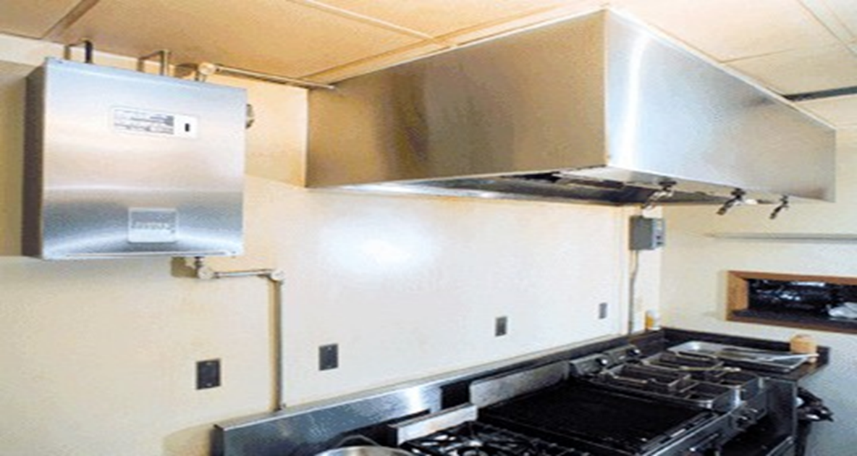
Suppression Systems
Where required
Accordance with NFPA installation standards

Slide 16
Commissioning and Integrated Testing
People involved
  Owner
  AHJ
  System designer
  General contractor
  Subcontractor
  Fire protection engineering consultants
  Test and balancing technicians
Documentation produced
Multiple stages
Integrated testing

Slide 17
Commissioning
Approved plan
Inspection of components
Testing of system operation
  Emergency, normal, and change of power status
  Performance criteria
  Test all related systems
Sequence of operations
Design parameters

Slide 18
Special Inspector
Must check all performance criteria
Special training and equipment
Iterative process

